Slide 1
Visual Analytics and Visual Computing
Mod.100/1

Slide 2
Outline

Introduction
Visual Computing and its main goal.

Visual Computing for the Industry 4.0
Visual Computing as enabling technology for the industrial sector, Solutions, main Technologies.

Immersive Analytics
Recent advancements and research trends.

Visual Computing for Medicine
Visualization in Medicine, Medical Imaging Modalities, Medical Image processing, Visual Computing Technologies for Medicine, Usages and Case Studies.

Video Analytics
Definition, Motivations, Market Analysis, Video Processing techniques, Solutions and Applications.

Slide 3
Visual Analytics and Visual Computing
Visual Computing is a generic term for all computer science disciplines handling with images and 3D models.
Recent advances in visual computing technologies, including virtual and augmented reality, HMI (Human Machine Interaction) interfaces, collaborative robotics interaction, and visual analytics, provide added opportunities to explore, discover, and analyze data that augment current analytics methods and decision support.

Slide 4
Visual Computing Goal
Visual Analytics and Visual Computing
Deriving insights from data by enhancing the user experience with new visual computing technologies such as new displays, inputs, and interaction techniques to increase user engagement and productivity for data analysis applications.

Slide 5
Visual Computing for the I4.0
Overview

Slide 6
Visual Computing for the I4.0
Visual Analytics and Visual Computing
Key enabling technology for Industry 4.0
Improving productivity and efficiency in the Industrial sector.
Empowering human operators by giving them tools and solutions for improving their decision-making processes.

Slide 7
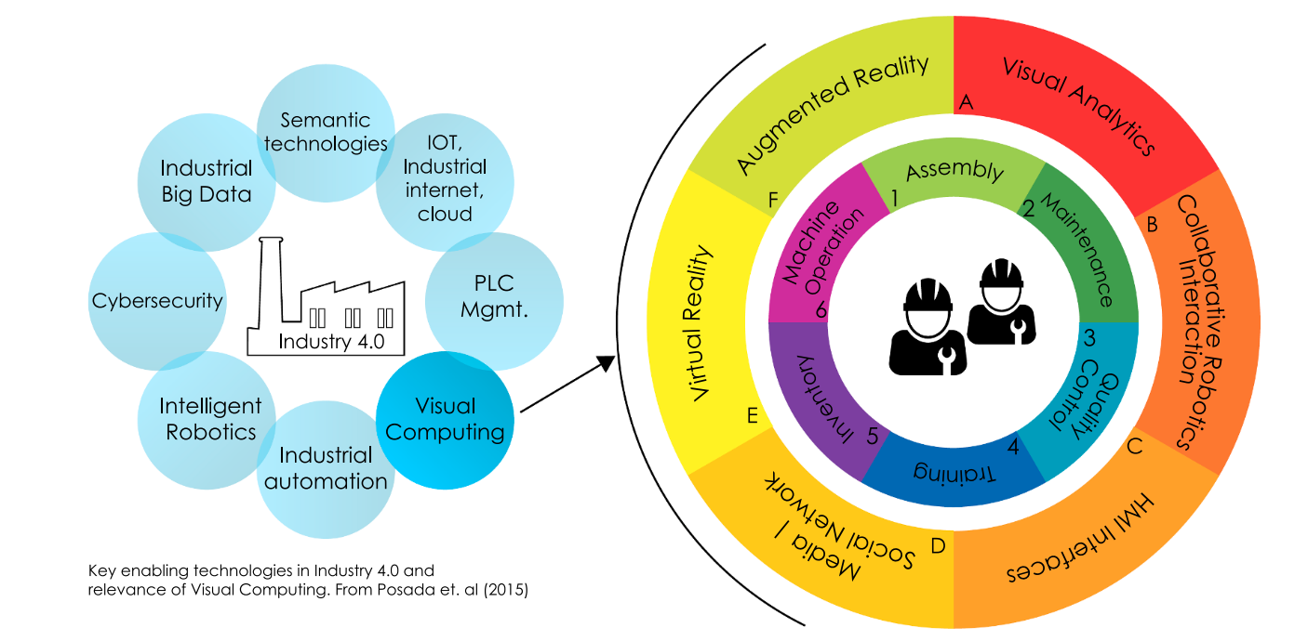
Visual Computing for the I4.0 - Technologies
Visual Analytics and Visual Computing
Visual Analytics: Provides easy to understand depictions of large amount of data and relations that are not immediately seen.
Source: [1]

Slide 8
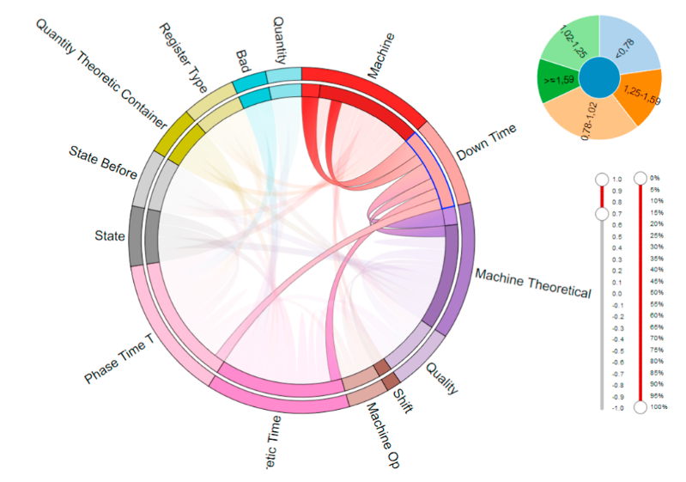
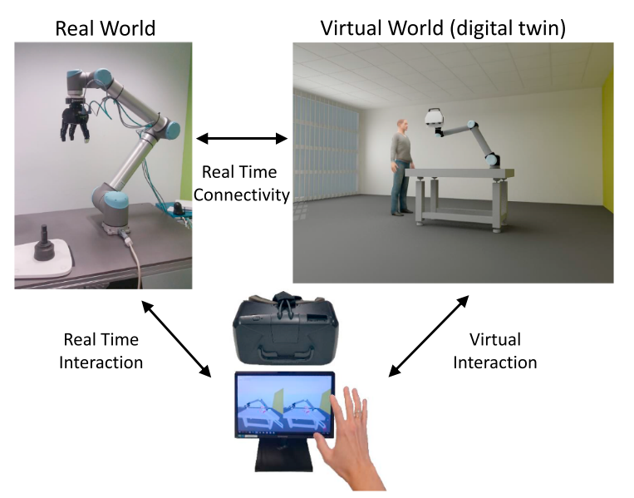
Visual Computing for the I4.0 – Tasks for Operator 4.0
Visual Analytics and Visual Computing
VR training scenario involving a robot Digital Twin
Visual Analytics for Overall-Equipment-Efficiency (OEE)
Source: [1]

Slide 9
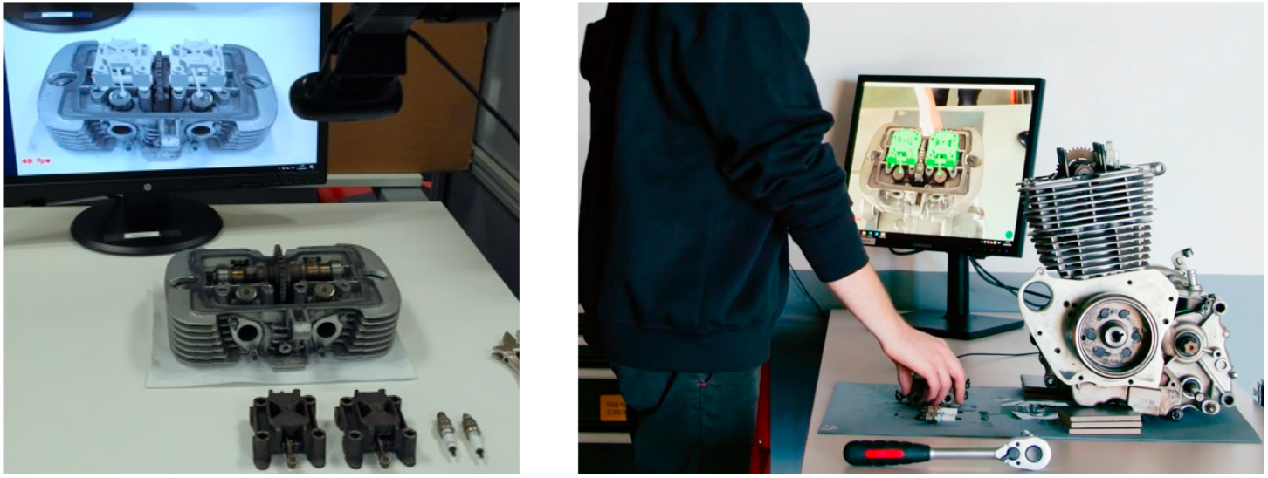
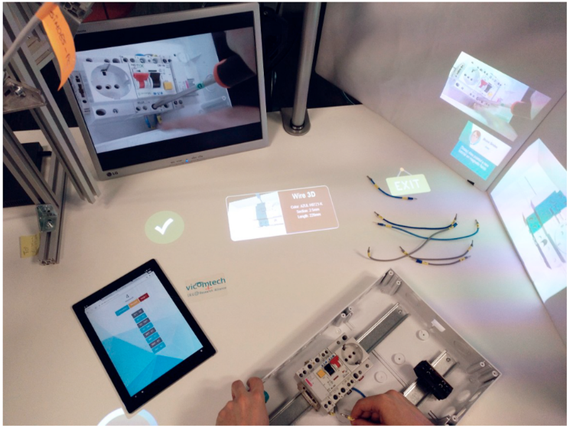
Visual Computing for the I4.0 – Tasks for Operator 4.0
Visual Analytics and Visual Computing
AR-assisted assembly of an engine
Assembly operator assistance setup for electric cabinet wiring
Source: [1]

Slide 10
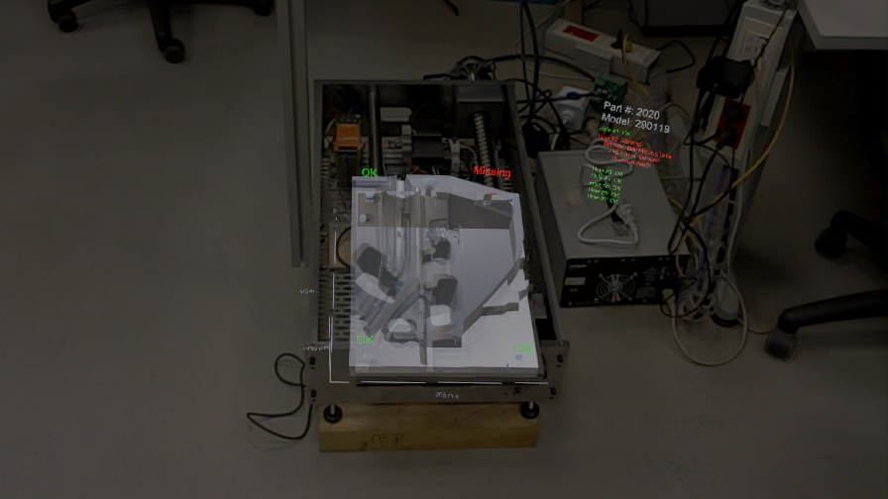
Visual Computing for the I4.0 – Tasks for Operator 4.0
Visual Analytics and Visual Computing
AR-Visualization for Mould Industry

Slide 11
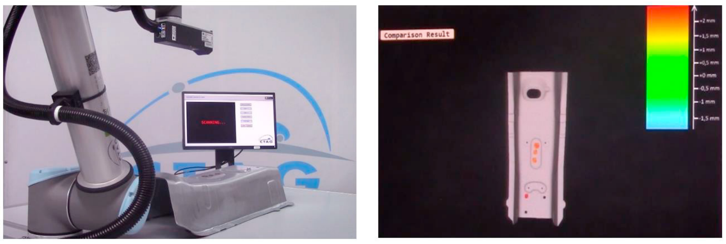
Visual Computing for the I4.0 – Tasks for Operator 4.0
Visual Analytics and Visual Computing
Machine vision metrology
Left: acquisition environment. Right: result of the inspection and measurement.
Source: [2]

Slide 12
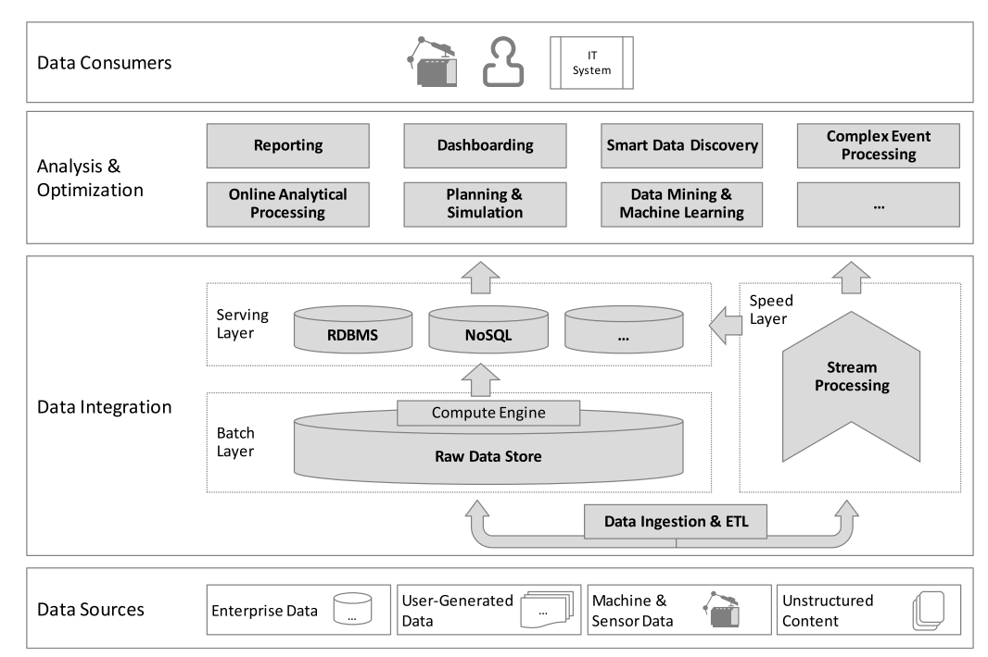
Visual Computing for the I4.0 – Bosch I4.0 Analytics Platform Conceptual Architecture
Visual Analytics and Visual Computing
Source: [3]

Slide 13
Immersive Analytics
Overview

Slide 14
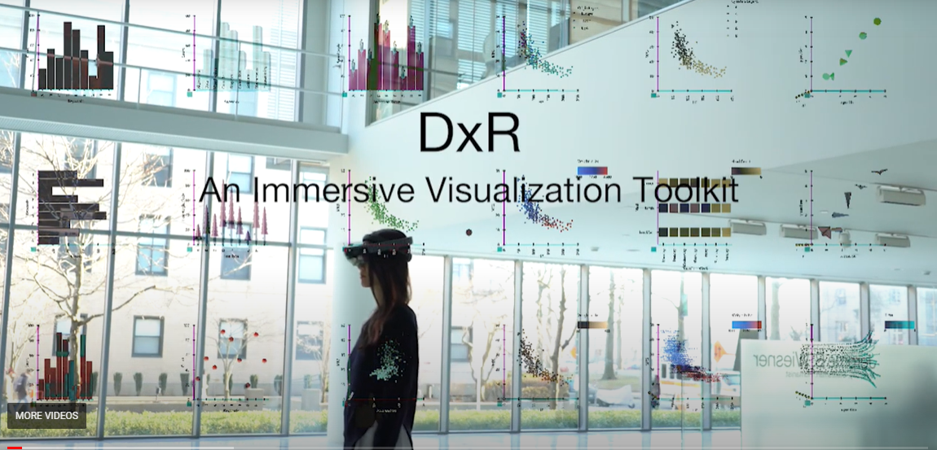
Immersive Analytics
Visual Analytics and Visual Computing
Advances in virtual and augmented reality to explore, discover, and analyze data.
Deriving insights from data
New display, input, and interaction techniques
https://sites.google.com/view/dxr-vis

Slide 15
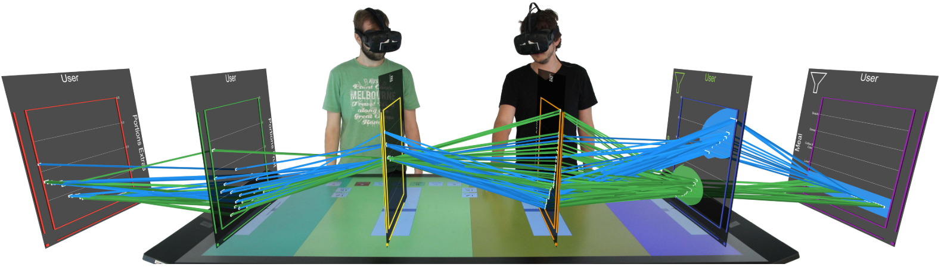
Immersive Analytics
Visual Analytics and Visual Computing
Augmented Reality is designed to facilitate the collaborative analysis of multidimensional data.
http://www.immersiveanalyticssurvey.org/

Slide 16
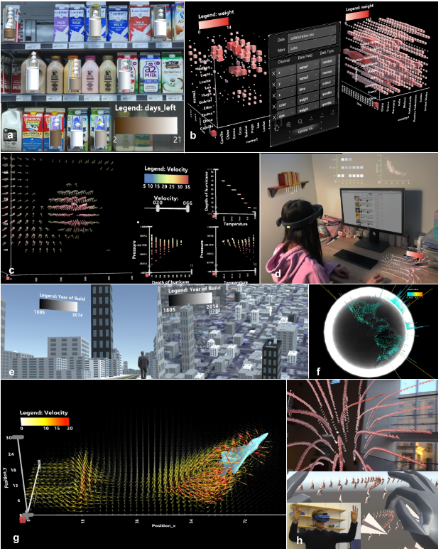
Immersive Analytics
Visual Analytics and Visual Computing
DXR: A Toolkit for Building Immersive Data Visualizations
Source: [5]

Slide 17
Visual Computing for Medicine
Overview

Slide 18
Visual Computing for Medicine
Visual Analytics and Visual Computing
Medical Visualization is a special area of Scientific Visualization.
Scientific visualization deals primarily with the visualization, exploration, and analysis of datasets arising from measurements or simulation of real world phenomena.
The underlying datasets of scientific visualizations are often very large, which makes it necessary to consider the efficiency and hence the time and space complexity of algorithms.

Slide 19
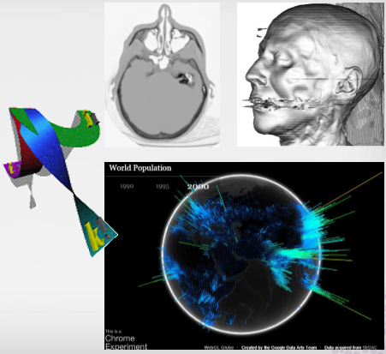
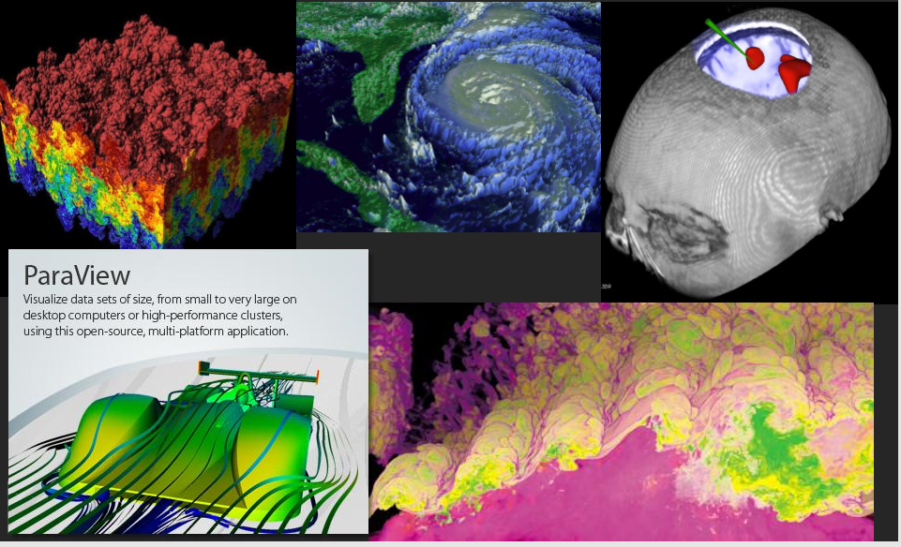
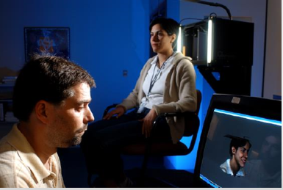
Visual Computing for Medicine - Scientific visualization
Visual Analytics and Visual Computing

Slide 20
Visual Computing for Medicine - Scientific visualization
Visual Analytics and Visual Computing
Goals of scientific visualization are:
To explore data (undirected search without a specific hypothesis).
To test a hypothesis based on measurements or simulations and their visualization.
The presentation of results.
Example:
Computer support, in particular image processing, quantitative image analysis, and visualization, may improve the radiologist’s diagnosis.
The ultimate goal of such visualizations and the attached report is to support treatment decisions.

Slide 21
Visual Computing for Medicine - Scientific visualization
Visual Analytics and Visual Computing
Thus,
It is essential to understand what kind of “insight” particular users want to achieve.
Another consequence is that interaction plays a crucial role in the design of medical visualization systems.
Interaction should support the user in navigating within the data:
Selecting relevant portions during exploration.
Comparing data from different regions or different datasets.
Adjusting and fine-tuning of visualization parameters that define after all the optical properties observable by a human.

Slide 22
Visual Computing for Medicine – Medical Imaging
Visual Analytics and Visual Computing
Medical image data are acquired for different purposes, such as diagnosis, therapy planning, intraoperative navigation, and postoperative monitoring.
The most important and widespread use of medical image data is for diagnostics.

Slide 23
Visual Computing for Medicine – Medical Imaging Modalities
Visual Analytics and Visual Computing
Major requirements that guide the selection of imaging modalities in practice:
the relevant anatomy must be depicted completely.
the resolution of the data should be sufficient to answer specific diagnostic and therapeutic questions.
the image quality with respect to contrast, signal-to-noise ratio (SNR) and artifacts must be sufficient to interpret the data with respect to diagnostic and therapeutic questions.
exposure and burden to the patient and to the medical doctor should be minimized.
costs should be limited.

Slide 24
Visual Computing for Medicine – Medical Imaging Modalities
Visual Analytics and Visual Computing
Medical image data is usually represented as a stack of individual images.
Each image of a volume dataset represents a thin slice of the scanned body part and is composed of individual pixels (picture elements).
A modality is a specific image acquisition technique, such as X-ray, CT or MRI.

Slide 25
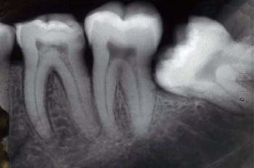
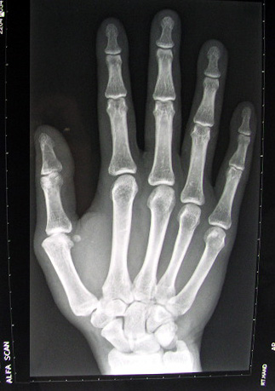
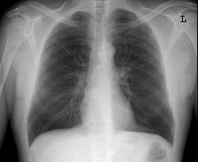
Visual Computing for Medicine – X-Ray
Visual Analytics and Visual Computing
Image Formation
A beam of X-rays is directed through a patient onto a film.
The film provides a measure of the ray attenuation in tissue
Excellent for imaging bones.
No depth information, bad for soft tissue, excessive radiation
X-ray images were the first medical image data exposing information about inner structures inside the human body and it is still by far the most used image modality in modern health care
Today, images generated by X-rays are typically provided as digital image data

Slide 26
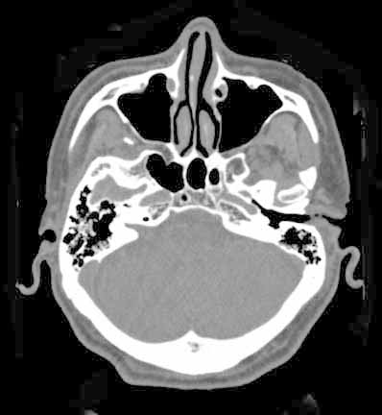
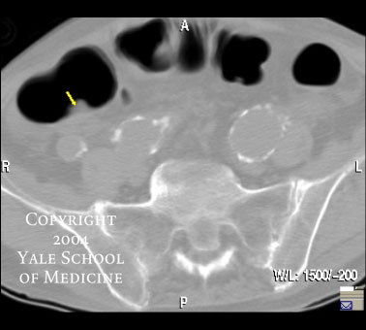
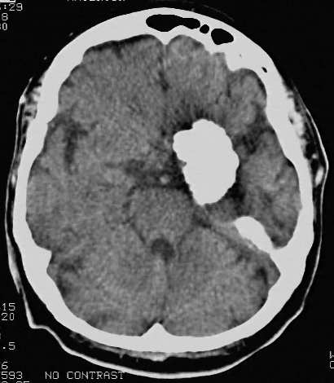
Visual Computing for Medicine – Computed Tomography (CT)
Visual Analytics and Visual Computing
Image Formation
The object is viewed from a number of different angles and then a cross-sectional image of it can be computed (reconstructed).
Provide 3D anatomical information
Preserves topology (bones)
Excessive radiation
Not good for all soft tissues

Slide 27
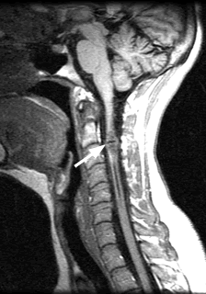
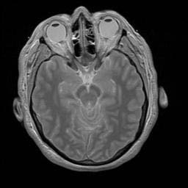
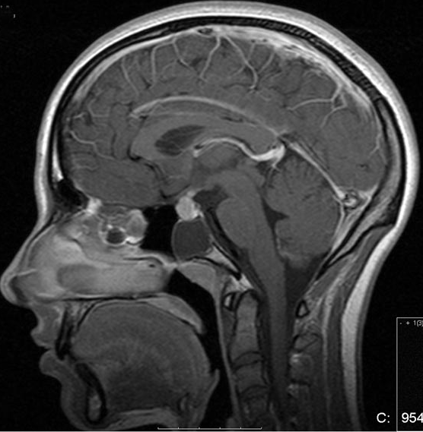
Visual Computing for Medicine – Magnetic Resonance Imaging (MRI)
Visual Analytics and Visual Computing
Image Formation
Hydrogen nuclei (protons) under a strong magnetic field spin in phase with one another and aligned with the field.
Relaxed protons induce a measurable radio signal.
Main modality for image guided surgery.
Superb ability to discriminate between subtle differences in tissue characteristics.
Very safe.
Less accurate for bone scanning.

Slide 28
Visual Computing for Medicine – Medical Image Data
Visual Analytics and Visual Computing
CT and MRI dominate due to their high resolution and their good signal-to-noise-ratio.
The image resolution has increased considerably, with the introduction of Multi-slice CT devices in 1998.
Also, the acquisition times have decreased—this development contributes to the quality of medical volume data because motion and breathing artifacts are reduced considerably.
The acquisition of time-dependent volume data, which depict dynamic processes in the human body, has been improved with respect to spatial and temporal resolution.

Slide 29
Visual Computing for Medicine – Medical Volume Data in Clinical Practice
Visual Analytics and Visual Computing
Medical image data are physically stored together with the information that is essential for the interpretation of the images.
This information is highly standardized as DICOM standard (Digital Imaging and Communications in Medicine).
DICOM enables digital communication between diagnostic and therapeutic equipment and systems from various manufacturers.
Currently, most manufacturers of CT and MRI scanners are officially accredited as being DICOM conform, which means that their output meets the specification of the DICOM standard.

Slide 30
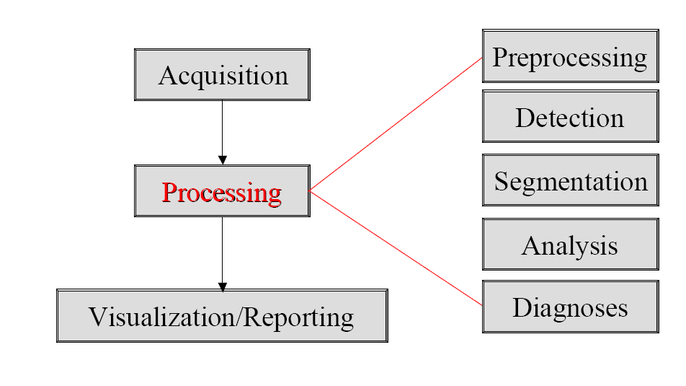
Visual Computing for Medicine – Medical Image Processing
Visual Analytics and Visual Computing
Pre-processing
Filtering, registration
Detection
Finding objects (nodules, polyps, organs)
Segmentation
Exact delimitation of objects
Analysis
Measurement (volume, curvature)
Classification/diagnoses

Slide 31
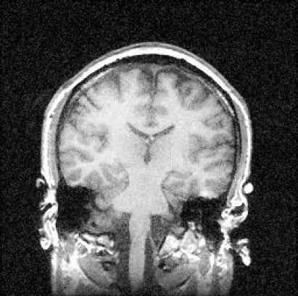
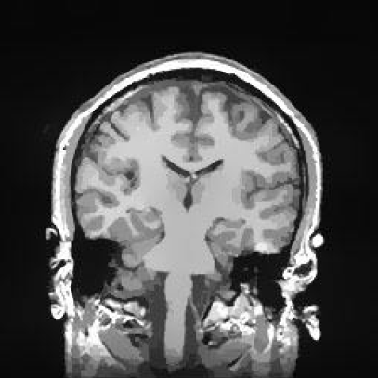
Visual Computing for Medicine – Medical Image Processing - Preprocessing
Visual Analytics and Visual Computing
Original
Enhanced

Slide 32
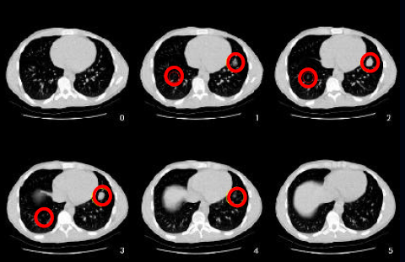
Visual Computing for Medicine – Medical Image Processing - Detection
Visual Analytics and Visual Computing
Find location of objects of interest without prior knowledge about their location/existence
Bones
Organs
Polyps in colon
Nodules in lungs

Slide 33
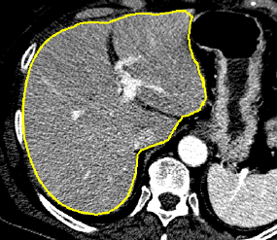
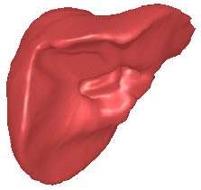
Visual Computing for Medicine – Medical Image Processing - Segmentation
Visual Analytics and Visual Computing
Exactly delimitate objects, once they are detected.
Vessels
Liver
Cardiac imaging (left ventricle)
Brain

Slide 34
Visual Computing for Medicine – Medical Image Processing - Analysis
Visual Analytics and Visual Computing
Measurement
Volume - growth
Vessel stenosis
Functional imaging
Stroke
Cardiac perfusion
Tumor perfusion
Cardiac function
LV motion
Injection fraction

Slide 35
Visual Computing for Medicine – Medical Image Processing - Classification / Diagnoses
Visual Analytics and Visual Computing
Classify as normal/abnormal (brain).
Classify lung nodules as benign/malignant.
Determine cancer/non-cancer.
Use of knowledge databases.

Slide 36
Visual Computing for Medicine – Application areas and Case Studies
Visual Analytics and Visual Computing
The main application areas of Medical visualization are:
Diagnosis
Treatment planning
Intraoperative support
Documentation
Educational purposes.
Medical research

Slide 37
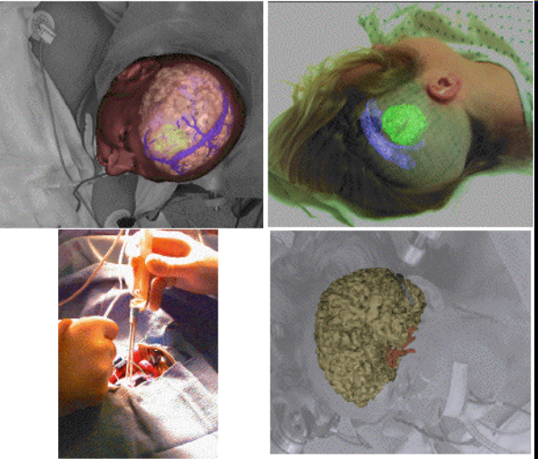
Visual Computing for Medicine – Augmented Reality in Neurosurgery
Visual Analytics and Visual Computing

Slide 38
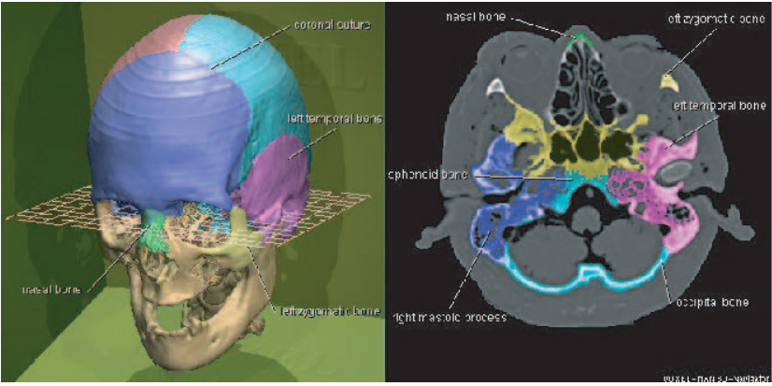
Visual Computing for Medicine – Medical Imaging for Educational Purposes
Visual Analytics and Visual Computing
2D and 3D visualization of a high-resolution dataset for anatomy education

Slide 39
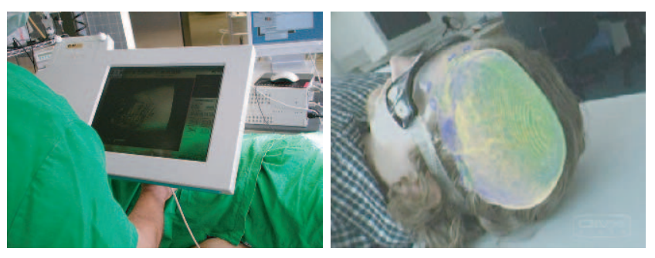
Visual Computing for Medicine – Medical Visualization
Visual Analytics and Visual Computing
Intraoperative use of medical Visualization

Slide 40
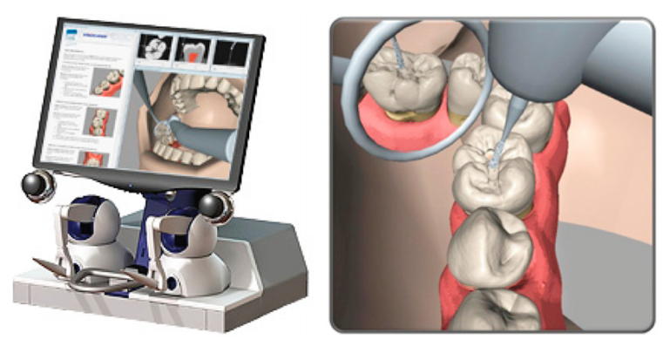
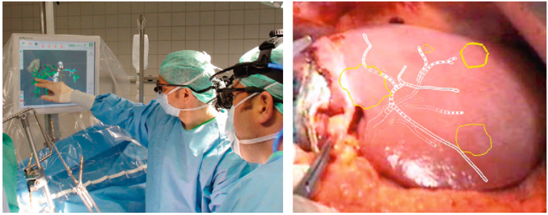
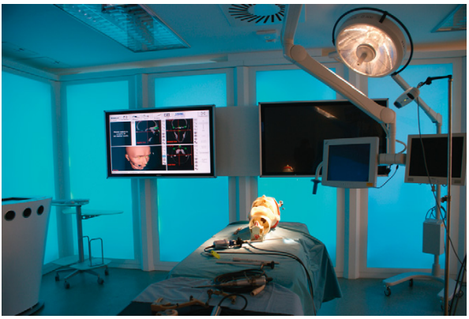
Visual Computing for Medicine – Medical Visualization
Visual Analytics and Visual Computing
Preoperative planning
3D Visualization of the dental anatomy
Surgical planning and preparation

Slide 41
Visual Computing for Medicine – AI and Medical Imaging
Visual Analytics and Visual Computing
With the growth in imaging, it becomes a challenge for radiologists to deal with the increased volume and focus on the right studies.
AI is helping process images, detecting patterns to reduce workloads.
improving radiology and detection workflows, utilizing deep learning techniques, and enabling real-time interpretation of echocardiography tests.
The latest machine learning, deep learning, and workflow automation technology can accelerate interpretation, improve accuracy, and reduce repetition for radiologists and other specialties.

Slide 42
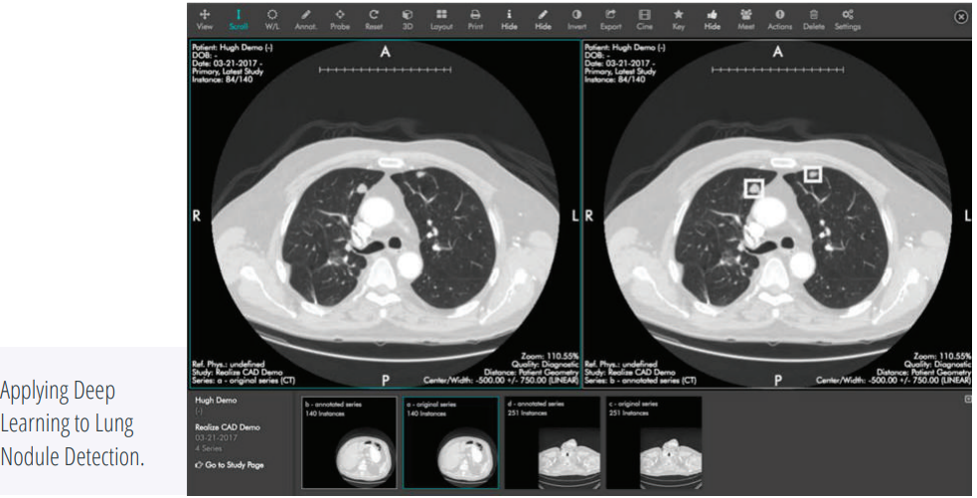
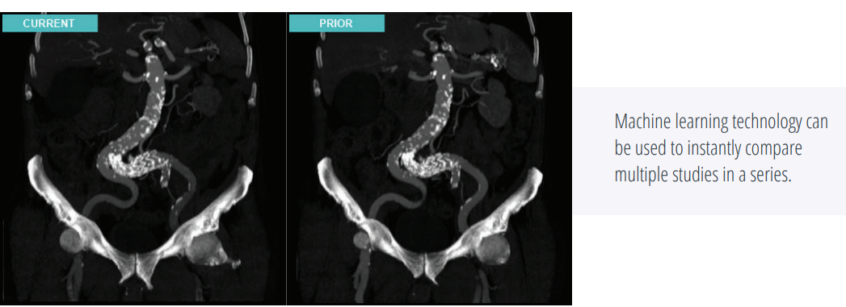
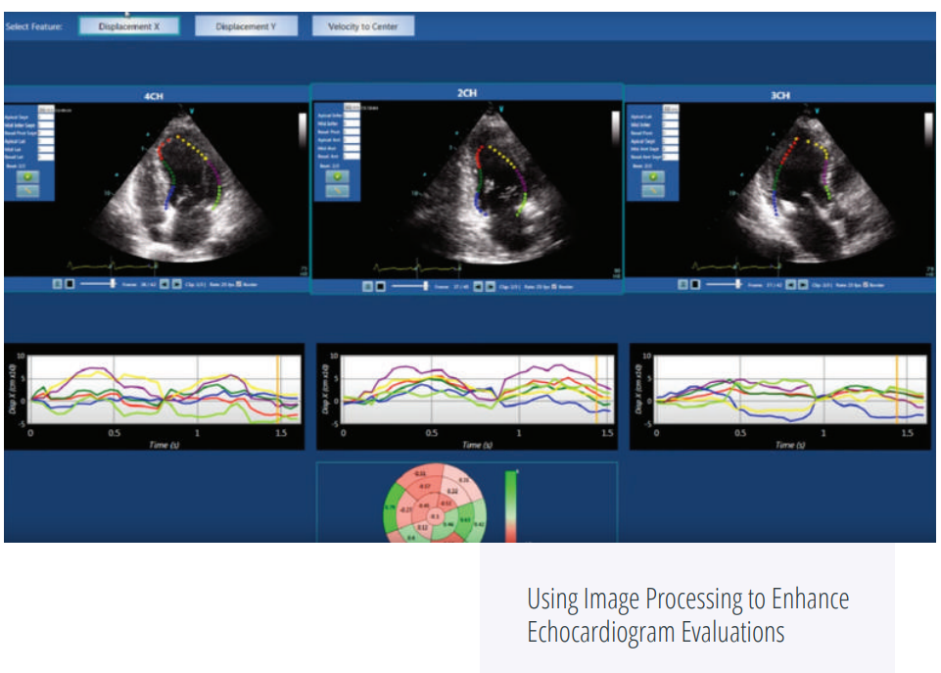
Visual Computing for Medicine – AI and Medical Imaging
Visual Analytics and Visual Computing

Slide 43
Visual Computing for Medicine – Tools and Software
Visual Analytics and Visual Computing
BioDigital https://www.biodigital.com/
MIPAV https://mipav.cit.nih.gov/
OsiriX https://www.osirix-viewer.com/
iMSTK https://www.imstk.org/
Datasets
http://www.osirix-viewer.com/datasets/
https://github.com/pixmeo/osirix
Voreen https://www.uni-muenster.de/Voreen/index.html
MeVisLab https://www.mevislab.de/
https://www.osirix-viewer.com/
3D Slicer https://www.slicer.org/

Slide 44
Visual Computing for Medicine – Examples
Visual Analytics and Visual Computing
3D Slicer + VR https://www.youtube.com/watch?v=VzVjvnKuBAE
DICOM Director Demo for HoloLens https://www.youtube.com/watch?v=L4FhmXsnHTg
Biomedical Image analysis: research group https://biomedia.doc.ic.ac.uk/research/

Slide 45
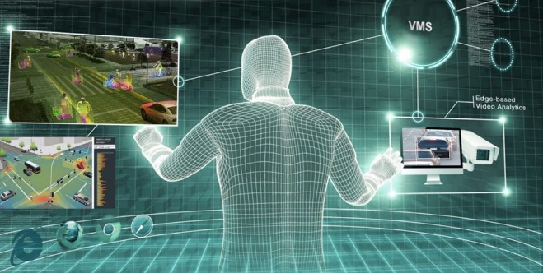
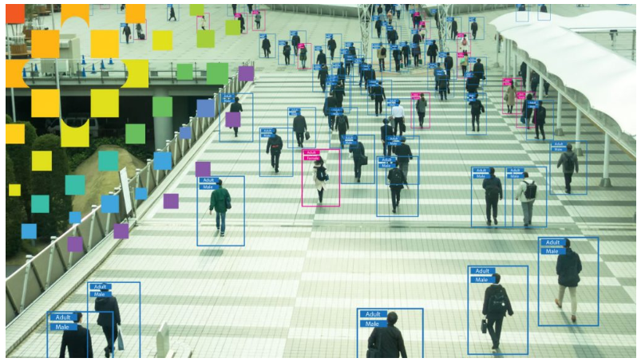
Video Analytics
Overview

Slide 46
Video Analytics
Visual Analytics and Visual Computing
Video content analysis (also video content analytics, VCA) is the capability of automatically analysing video to detect and determine temporal and spatial events (Wikipedia).
Video Analytics deals with the extraction of data from incoming video and the generation of results that are meaningful to humans.
Video analytics systems track video frames of cars, individuals, and other items to offer better surveillance and safety solutions.

Slide 47
Video Analytics
Visual Analytics and Visual Computing
With the emergence of advanced technology, intelligent and smart video analytics services offer reliable and precise monitoring and can capture incidents that get unnoticed by humans.
Implementation of video analytics would keep track of various cameras, analyze suspicious activities and send alert notification to the concerned authorities to take safety precautions.

Slide 48
Video Analytics - Motivations
Visual Analytics and Visual Computing
The amount of videos is growing rapidly across industries.
A recent IDC report projects that 79.4 zettabytes of data will be created by connected Internet of things (IoT) devices by 2025, mostly generated by video applications.
Harnessing the full potential of this content deluge is no small task.

Slide 49
Video Analytics - Motivations
Visual Analytics and Visual Computing
Manual video analysis is a slow, labours and prone to errors.
Over 41B hours of video footage is captured weekly1 , but only a fraction of cameras and sensors provide any sort of intelligence.
Failure to fully optimize content or effectively monitor and respond to live video can result in missed opportunities for a variety of industries.

Slide 50
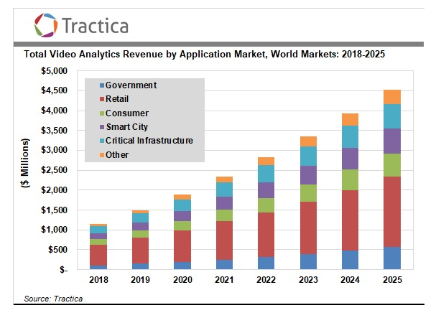
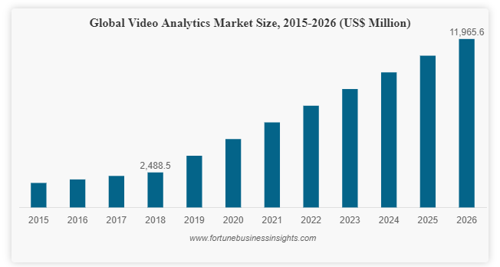
Video Analytics - Market Analysis
Visual Analytics and Visual Computing
The demand for Video Analytics solutions is increasing which enabling rapid market growth.
The global market was valued at US$ 2,488.5 Mn and is anticipated to reach US$ 11,965.6 Mn by 2026.

Slide 51
Video Analytics - Key Applications and Use cases
Visual Analytics and Visual Computing
Video Analytics
Government
Consumer
Critical Infrastructure
Transportation and Traffic Security
Smart City
Retails
Retails
Consumer Behaviour
Security
Marketing
Operation Optimization
Smart City
Traffic Management
Traffic Enforcement
Crowd Management
Critical Infrastructure
Government
Traffic Enforcement
Law Enforcement
Consumer
Home Security
Baby Monitoring
Others

Slide 52
Video Analytics - Architecture
Visual Analytics and Visual Computing
Two Perspectives
Server based - IP Cameras or Encoders connected via Ethernet to a Server.
Edge based - Self contained analytics using smart Cameras.

Slide 53
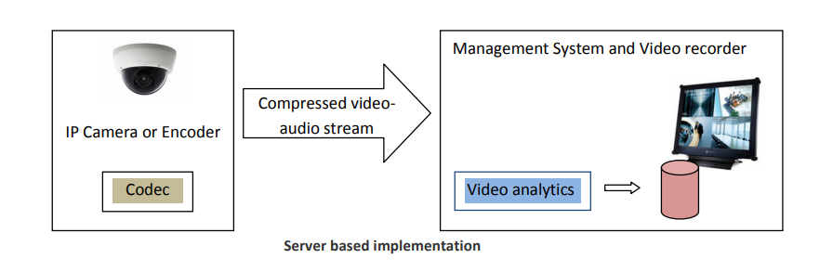
Video Analytics - Architecture
Visual Analytics and Visual Computing

Slide 54
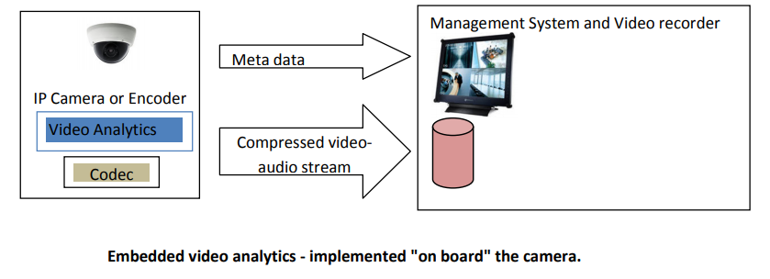
Video Analytics - Architecture
Visual Analytics and Visual Computing

Slide 55
Video Analytics - Transform Video into Insights
Visual Analytics and Visual Computing
Many industries are now exploring the use of AI to rapidly analyze live and archived video to gain a deeper understanding of customers, infrastructure and operations.
Benefits such as:
Enabling proactive responses – Delivering near real-time alerts when potentially problematic circumstances or events are captured on video, such as a nearly empty shelf in a store, an inappropriate gesture during a broadcast, a railway platform becoming overly crowded or a suspicious item left in a public zone.
Monetizing archived content – Creating rich metadata that can be searched and shared based on the objects, events, people and locations that appear in the video.
Enhancing operational insights – Measuring human and vehicle traffic in a specific area to identify movement patterns, dwell times, and common areas of congestion.
Supporting worker wellbeing – Identifying potentially dangerous situations and alerting personnel.
Identifying and removing inappropriate content – Monitoring people, behaviours and logos in real-world and digital spaces so that unwanted and inappropriate content can be flagged and addressed.

Slide 56
Video Analytics - Intelligent Video Analytics Tasks
Visual Analytics and Visual Computing
Understand the context of the entire scene and its background
Object detection
detect the object in a video frame.
Object/character recognition
recognize detected object.
Object tracking
monitor behaviour of detected object.
Create a structured database of information out of the unstructured video data for granular search, comprehensive report and smart alerting.

Slide 57
Video Analytics - Features
Visual Analytics and Visual Computing
Video Processing Features of VA system
Person Detection and Facial Recognition
Motion Detection and Extraction
Person Tracking
Emotion Analysis
People Counting
Optical Character Recognition OCR
Video Tagging and search

Slide 58
Video Analytics - Challenges
Visual Analytics and Visual Computing
The AI-dominated video analytics requires higher bandwidth, consumes considerable CPU/GPU resources for processing, and demands larger memory for caching.
Key Issues in Production Environment
False Alarms
Camera Resolution, lighting , Distance, and Installation
Real-time Computation
Power Consumption
Use of AI and Expertise
Scaling and Hardware acceleration

Slide 59
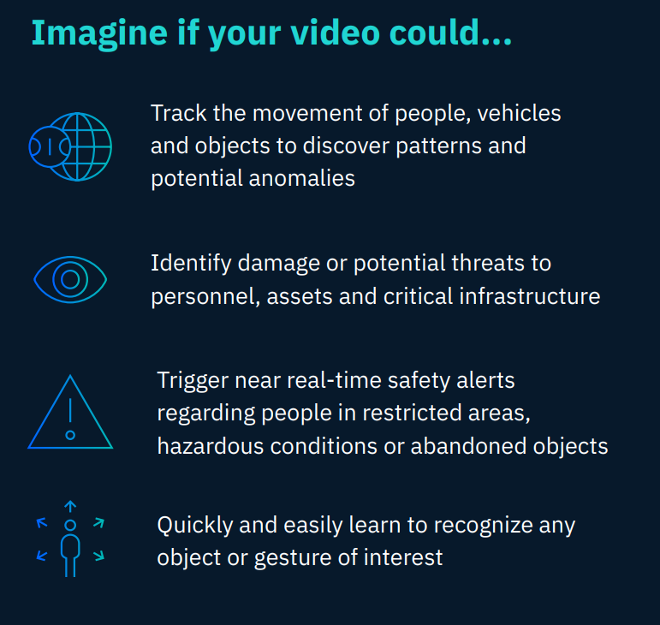
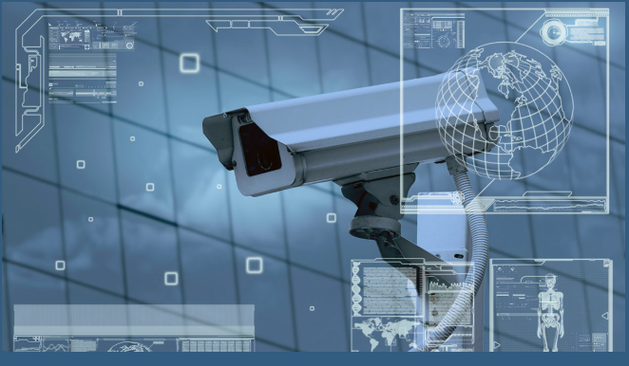
Video Analytics – Solutions – IBM Video Analytics
Visual Analytics and Visual Computing
Cameras capture the video, but video analytics captures the value.

Slide 60
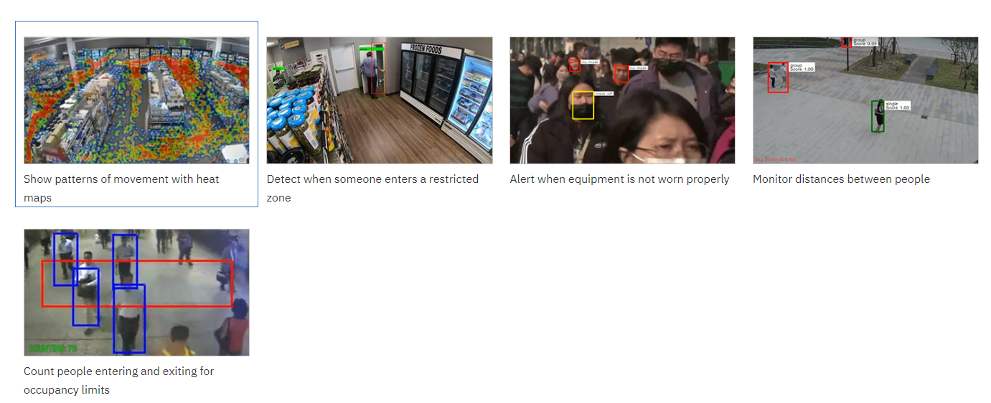
Video Analytics – Solutions – IBM Video Analytics
Visual Analytics and Visual Computing

Slide 61
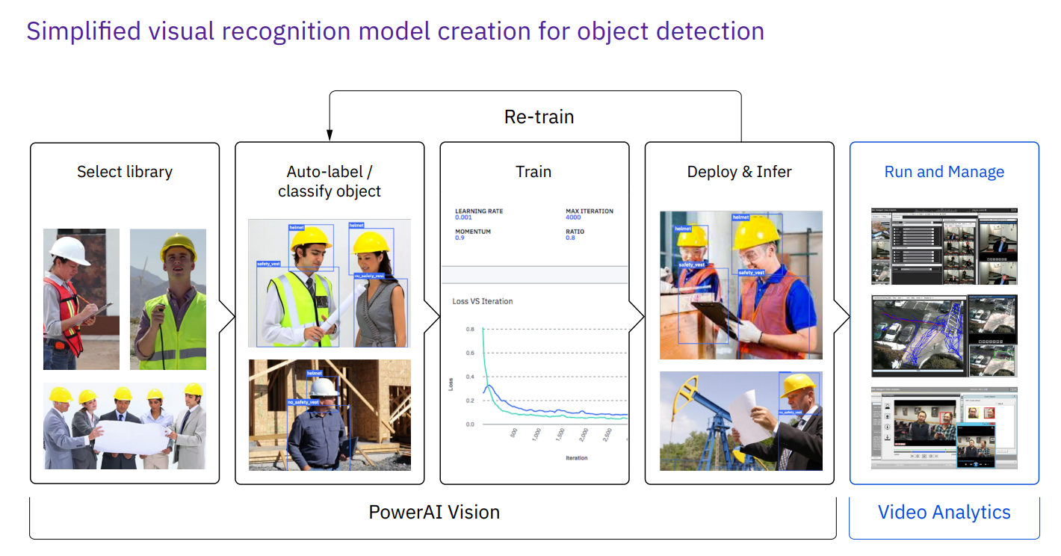
Video Analytics – Solutions – IBM Video Analytics
Visual Analytics and Visual Computing

Slide 62
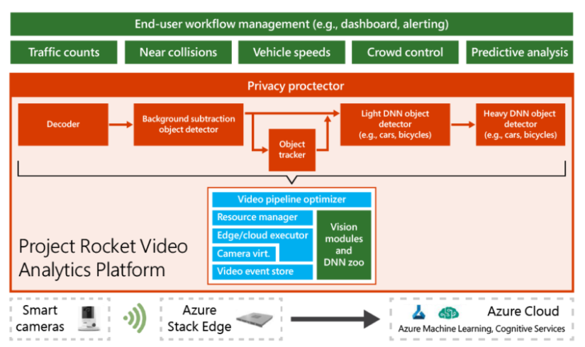
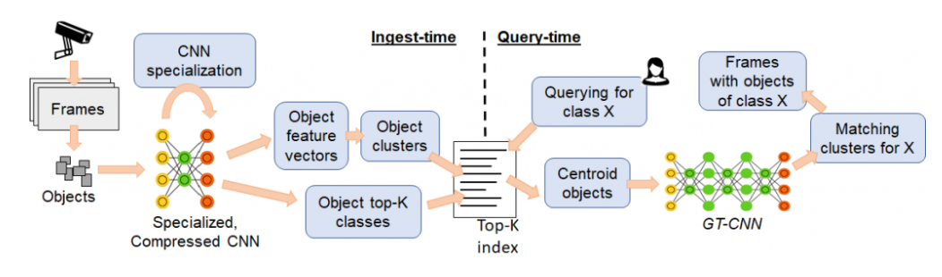
Video Analytics – Solutions – Project Rocket platform
Visual Analytics and Visual Computing
Project Rocket platform—designed for easy, customizable live video analytics by Microsoft
Querying large video datasets with low latency and low cost
https://www.microsoft.com/en-us/research/project/live-video-analytics/

Slide 63



Video Analytics – Solutions – Kitware
Visual Analytics and Visual Computing
Kitware https://www.kitware.com/computer-vision/
algorithms and software for automated image and video analysis

Slide 64
Video Analytics – Solutions
Visual Analytics and Visual Computing
SAMSUNG SDS Video Analytics https://www.youtube.com/watch?v=9h9WKDm3lR4
ACTi video analytics https://www.acti.com/products/video-analytics
5G Video Analytics https://www.nokia.com/networks/5g/use-cases/video-surveillance/?did=d0000000030q
Video AI https://cloud.google.com/video-intelligence/

Slide 65
Video Analytics – Fields for R&D
Visual Analytics and Visual Computing
Computing and storage – distributed and centralized.
Infrastructure – passive, active, intelligent, mobile and static (wireless/cellular) and hybrid
Artificial intelligence and new algorithms.
Machine learning, Deep learning, Computer vision 3D video
Face and gesture analysis
Anomaly detection in crowded scenes
Advanced video compression methods
Synopsis production, integration, information fusion
Video forensics
Data mining, big data search and retrieval
Video protection – cybersecurity
System approach (perimeter security, safe city)
Smart security , Smart mobility
Analysis of human behaviour for event detection

Slide 66

Video Analytics – Tools - TensorFlow Object Counting API
Visual Analytics and Visual Computing
Open-source framework built on top of TensorFlow and Keras that makes it easy to develop object counting systems. https://github.com/ahmetozlu/tensorflow_object_counting_api

Slide 67
Video Analytics – Video analytics and COVID-19
Visual Analytics and Visual Computing
Video analytics software, which deals with the extraction of information from video via computer vision, is emerging as a useful tool in the fight against COVID-19:
Infrared (IR) sensors
IR-based sensors cameras as body temperature screening tools for detecting elevated skin temperature in high traffic public crowded like airports or malls.
Facial recognition with mask
Facial recognition video analytics for recognizing people when they are wearing masks for Airlines companies.

Slide 68
Video Analytics – Video analytics and COVID-19
Visual Analytics and Visual Computing
Social distancing warnings and alerts
Video analytics feature that generates alerts when people are spotted close to each other (social distancing) or touch something they are not supposed to.
Personal equipment protective
Video analytics software could be enhanced to generate an alert when a construction worker is spotted in the field without gloves or a mask.

Slide 69



References
Visual Analytics and Visual Computing
Books

Slide 70
References
Visual Analytics and Visual Computing
Papers
[1] Á. Segura et al., “Visual computing technologies to support the Operator 4.0,” Comput. Ind. Eng., vol. 139, no. November 2018, p. 105550, 2020.
[2] V. Alonso, A. Dacal-Nieto, L. Barreto, A. Amaral, and E. Rivero, “Industry 4.0 implications in machine vision metrology: an overview,” Procedia Manuf., vol. 41, pp. 359–366, 2019.
[3] C. Gröger, “Building an Industry 4.0 Analytics Platform,” Datenbank-Spektrum, vol. 18, no. 1, pp. 5–14, 2018.
[4] C. Mehrotra, N. Chitransh, and A. Singh, “Visual Analytics: Scope and Challenges,” Lect. notes Comput. Sci., no. 4404, pp. 76–90, 2008.
[5] Sicat, R., Li, J., Choi, J., Cordeil, M., Jeong, W. K., Bach, B., & Pfister, H. (2019). DXR: A Toolkit for Building Immersive Data Visualizations. IEEE Transactions on Visualization and Computer Graphics, 25(1), 715–725. https://doi.org/10.1109/TVCG.2018.2865152

Slide 71
References
Visual Analytics and Visual Computing
Websites
https://fresnobserver.com/what-is-driving-the-video-analytics-market/3660/
https://www.fortunebusinessinsights.com/industry-reports/video-analytics-market-101114
https://www.eetimes.com/introduction-to-video-analytics/#
https://www.securityindustry.org/2016/07/22/the-state-of-security-video-analytics/
https://wso2.com/whitepapers/innovating-with-video-analytics-technologies-and-use-cases/
https://www.motionvillee.com/blog/an-introduction-to-video-analytics/
https://www.edge-ai-vision.com/2020/01/a-guide-to-video-analytics-applications-and-opportunities/
https://www.edge-ai-vision.com/2020/01/video-analytics-solutions-are-driven-by-the-need-for-safety-and-security-with-global-revenue-reaching-4-5-billion-in-2025/
https://www.ibm.com/us-en/marketplace/video-analytics/resources
https://business.weather.com/blog/capture-more-than-images

Slide 72
References
Visual Analytics and Visual Computing
Online Courses
Biomedical Image Analysis in Python (DataCamp)

Slide 73

Get In Touch
+351 253 510 580
www.ccg.pt
CCG-Centro-de-Computação-Gráfica
info@ccg.pt
Campus de Azurém
Centro de Computação Gráfica
4800-048 Guimarães
Portugal

Slide 74
Thanks

